Slide 1


The mobility of transcription factor TFIIF revealed by CryoEM
by
Hsin-Hung Lin
Advisor:
Dr. Wei-Hau Chang
Co-Advisor:
Dr. Chun-Cheng Lin
Program:
Chemical Biology and Molecular Biophysics
Taiwan International Graduate Program

Slide 2
Outline
Introduction
What is RNA polymerase
Transcription cycle & co-factor for regulation
Proposed function and structure of TFIIF
Why TFIIF is important?
Method
Cryo-sample preparation
Image collection and processing
Experimental Result
Total resolution and highlight side chain
3D classification tree
Form 1 - WH on Rpb10 : a new found in high definition
Form 2 - Cleft Nearby : a shaking bulk density
smFRET show multi mode
Discussion - Mobility of TFIIF
Big move — Cleft to Rpb10
Small move — Cleft Nearby vibrating
Conclusion
A clear interface for tfg2 WH and Rpb10
the mobility of tfg2 WH

Slide 3
What is TFIIF
Transcription Factor II F
Process; Reaction
Role
Name
It is a factor assisting RNA polymerase II to transcribe the target.

Slide 4
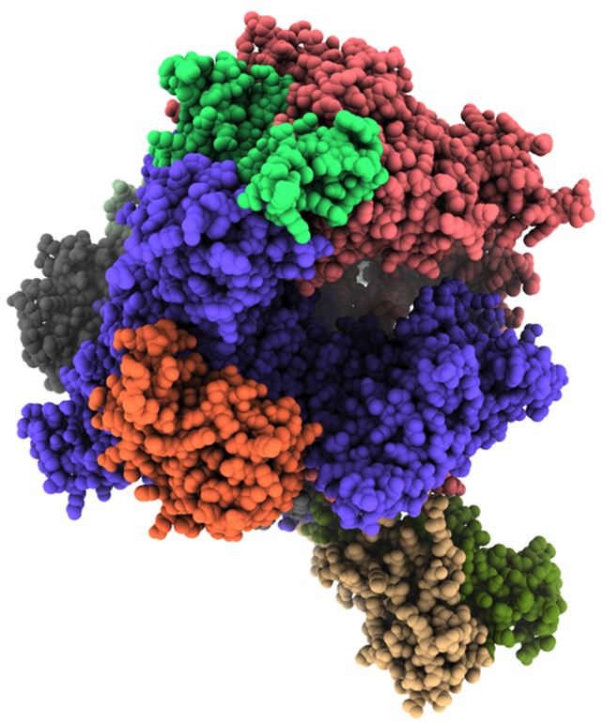
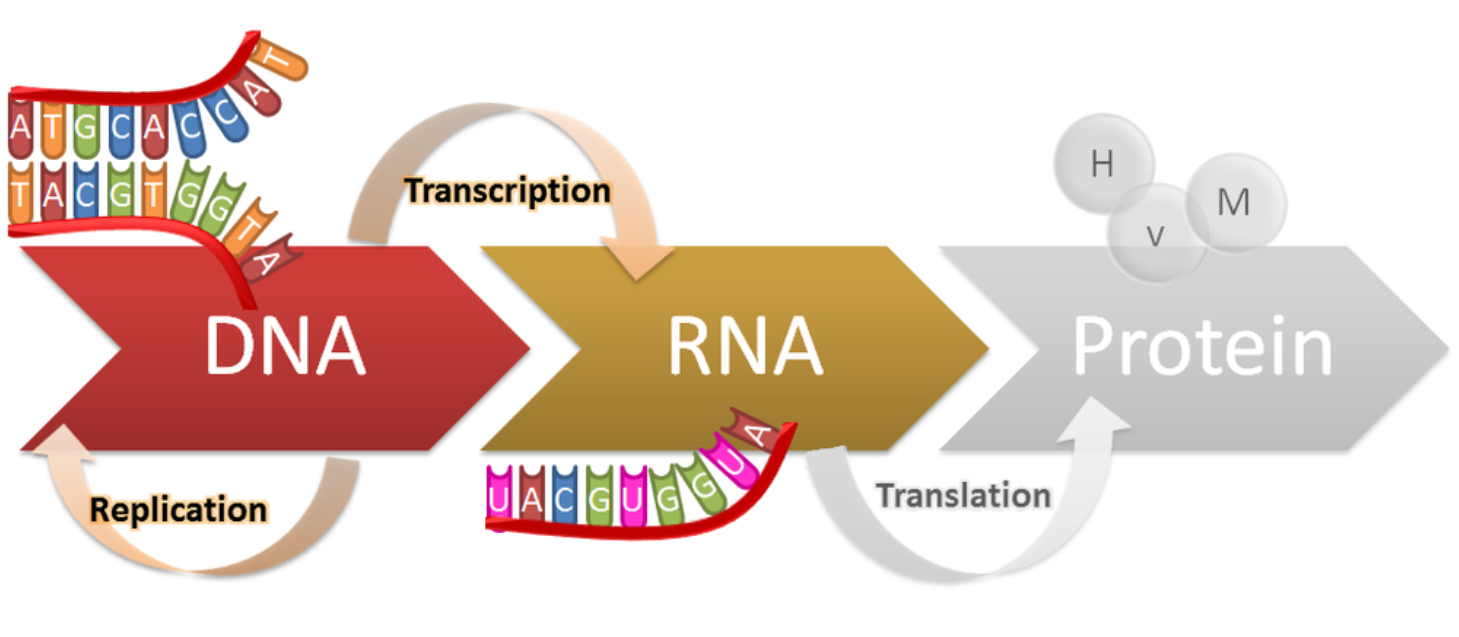
A Bio-machine for Transcription
RNA polymerase II
(RNAP-II)
Central Dogma
Notes:
https://kaiserscience.wordpress.com/biology-the-living-environment/genetics/dna-translation-and-the-genetic-code/
https://elizmalambert.com/reversing-dna-damage-in-chronic-illness-and-fertility/
就目前的理論來說，生命的一切訊息都encode在DNA裡面。當DNA所保存的遺傳訊息要被使用時，會透過兩個主要的步驟來讀取病轉換。
先將DNA 轉錄 (transcription) 成 RNA ，再將RNA調整後，轉譯 (translation) 成蛋白質。這樣使用DNA的方法，我們稱之為 中心定理
而我所研究的部分，以及今天要展現的部分，是關於 RNA polymerase, 那個在 transcription 過程中扮演主角的酵素，以及與其互動的輔助因子 TFIIF
Finn Werner's RNAP laboratory
https://sites.google.com/site/rnaplab/home
轉錄酶 RNA polymerase 運作的過程主要可以分成三個階段，初始化階段、連結階段、以及終止階段。
並且，如果依照目前已知的結構研究去分類的話，又可以將階段做更細的拆分
pre-initiation, initiation, pausing(check), Elongation, RNA cleavage, termination or re-initiation (3+4 step)

Slide 5
Transcription Cycle
IIA
IIH
IID
IIF
IIE
IIB
Initiation : RNAP bind to DNA
Elongation : RNA production
Termination : Cleavage & Recycle
** Each state needs co-factor
DNA
Initiation
Termination
Elongation
NELF
CF1A
RNA
DSIF
CPF
spt4
spt5
Xm2
Notes:
https://kaiserscience.wordpress.com/biology-the-living-environment/genetics/dna-translation-and-the-genetic-code/
就目前的理論來說，生命的一切訊息都encode在DNA裡面。當DNA所保存的遺傳訊息要被使用時，會透過兩個主要的步驟來讀取病轉換。
先將DNA 轉錄 (transcription) 成 RNA ，再將RNA調整後，轉譯 (translation) 成蛋白質。這樣使用DNA的方法，我們稱之為 中心定理
而我所研究的部分，以及今天要展現的部分，是關於 RNA polymerase, 那個在 transcription 過程中扮演主角的酵素，以及與其互動的輔助因子 TFIIF
Finn Werner's RNAP laboratory
https://sites.google.com/site/rnaplab/home
轉錄酶 RNA polymerase 運作的過程主要可以分成三個階段，初始化階段、連結階段、以及終止階段。
並且，如果依照目前已知的結構研究去分類的話，又可以將階段做更細的拆分
pre-initiation, initiation, pausing(check), Elongation, RNA cleavage, termination or re-initiation (3+4 step)

Slide 6
Proposed Function of TFIIF
TFIIF
TFIIF
Active site
DNA-RNA scaffold
RNAP
TFIIE
TFIIB
TBP
DNA
Initiation complex
Elongation Complex
IIB
IIE
IIF
Stabilizing initiation complex
DNA open complex formation
Start site selection
Stabilizing DNA scaffold
Notes:
Ref :
PIC 2012
TFIIF is not require for initiation but …… 2011
Position of TFIIF 2007

Slide 7
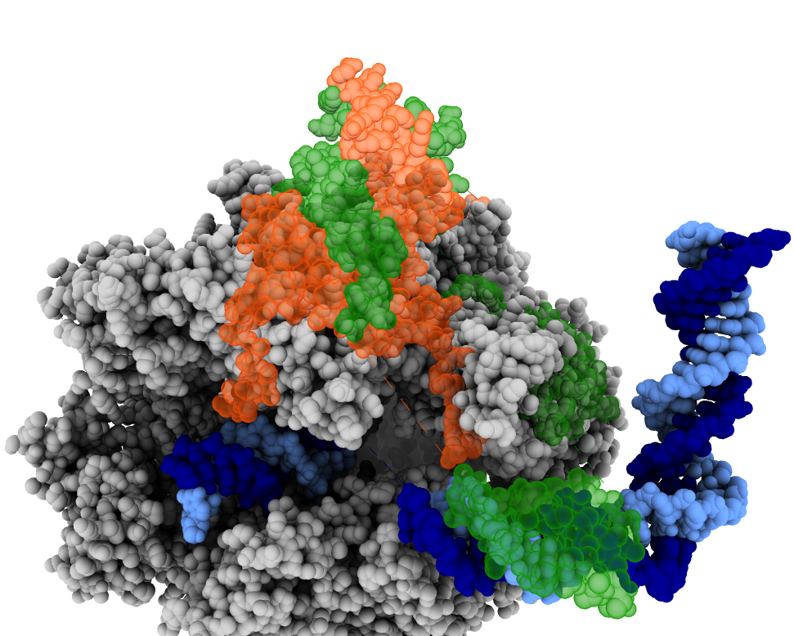
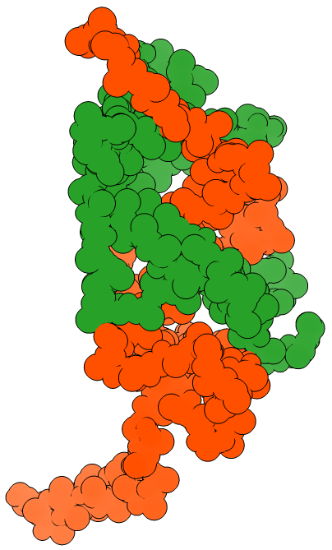
Proposed Structure of TFIIF in Initiation
TFIIF
(sitting on lobe)
Dimerization Domain (D-domain)
Lobe
Tfg2
Polymerase
core
protrusion
Tfg1
Wing Helix domain
(WH)
WH
Cleft
DNA
scaffold
Tfg1
PDB:5FYW
Total:735a.a.
21
35
98
167
305
400
Dimerization Domain (D-domain)
Wing Helix (WH)
Tfg2
Total:400a.a.
55
144
192
227
292
354
D-domain
WH

Slide 8
Why TFIIF is important?

Slide 9
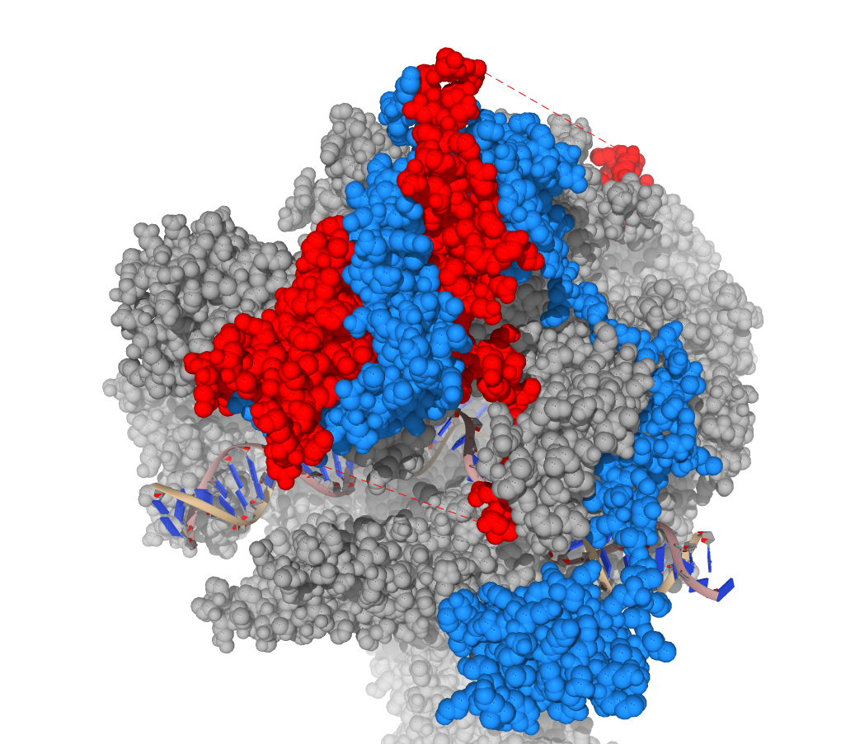
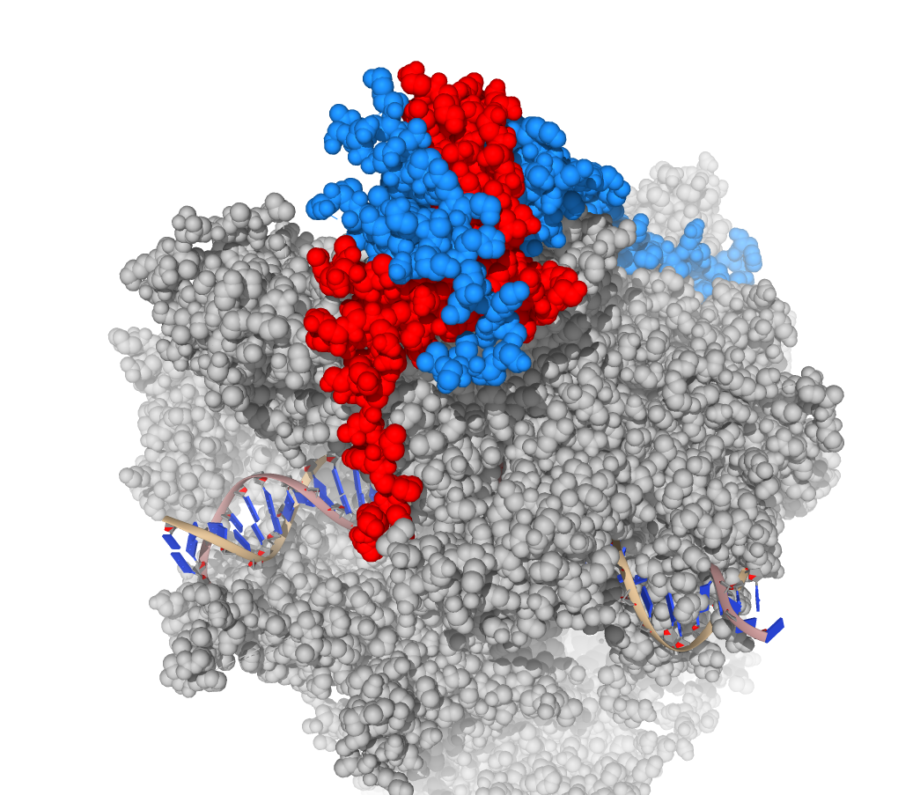
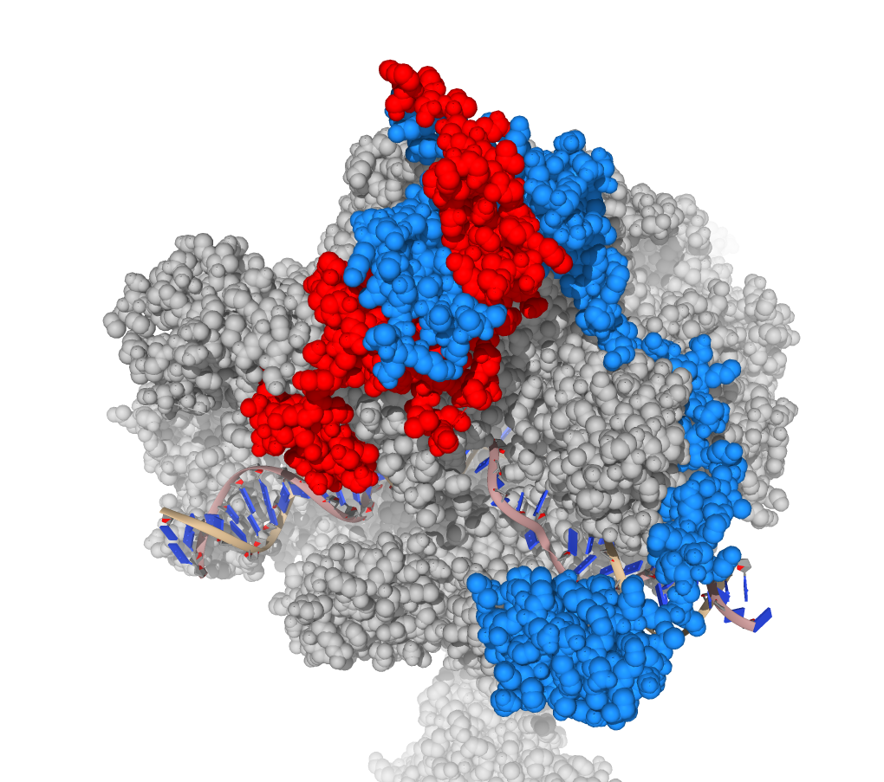
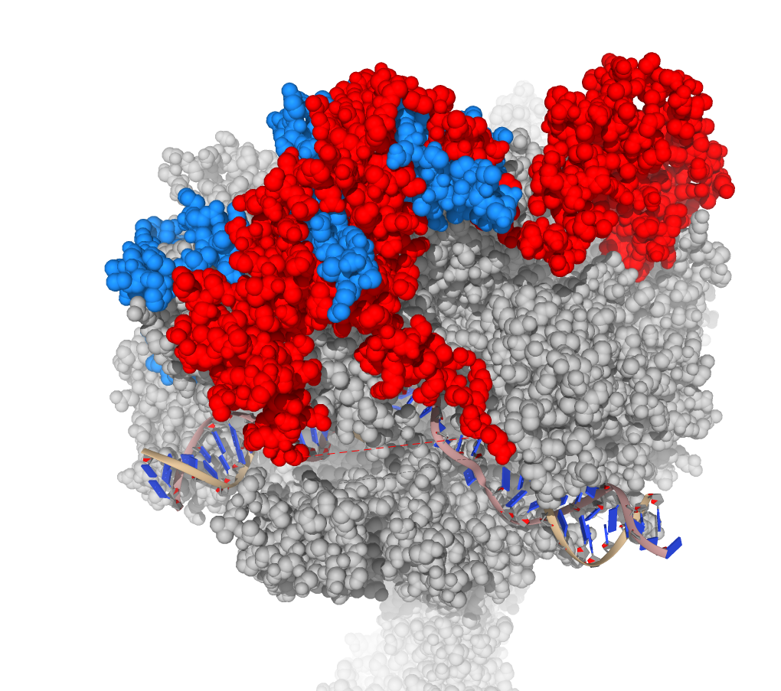
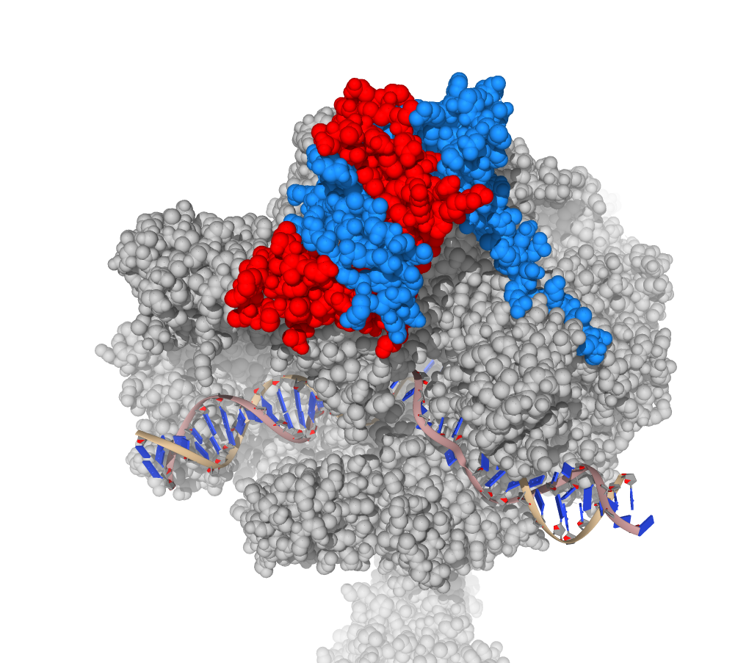
Homologous model of TFIIF
Internal subunit
Co-factor
Internal subunit
S.cere-Pol2
Tfg1/Tfg2
S.cere-Pol1
A49/A34.5
Homo-Pol2
RAP74/RAP30
Homo-Pol3
C37/C53
6RUI
7NVU
7AE1
Initiation
Homo-Pol2
EAF1/ELL2
Among species
Among type
7O4I
Among
state
7OKX
Elongation

Slide 10
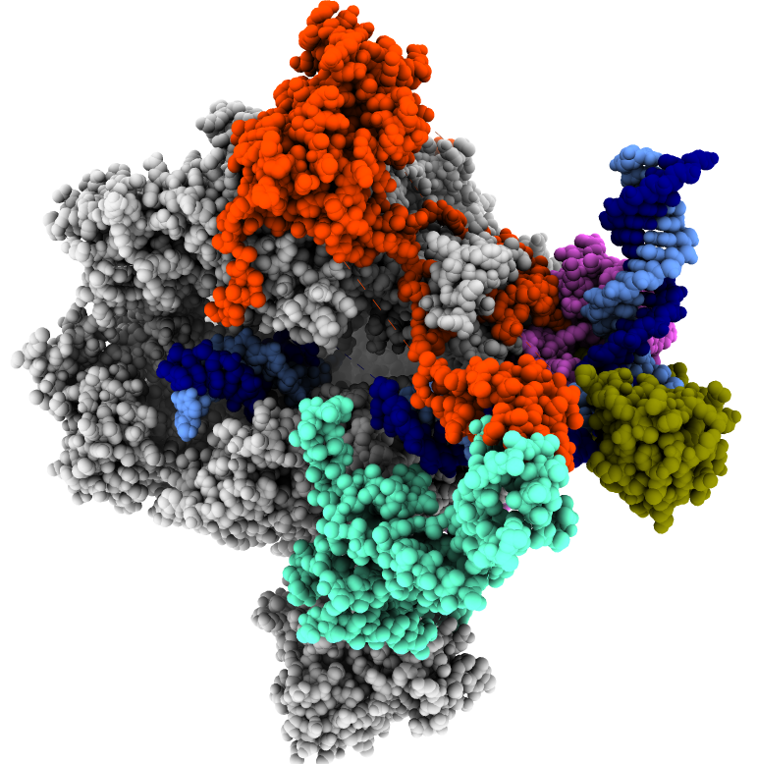
Elongation Complex with TFIIF is unknown
Elongation is the major process for transcription.
Functional assays indicated the existence of TFIIF.
There is no structural information to point out the interface between element.
IIF
IIB
TBP
IIE
Initiation
PDB:5FYW
By P. Cramer’s group
Transcription
Cycle
Elongation
Termination
With TFIIF
?
Notes:
補ＤＮＡ方向

Slide 11
Cryogenic Electron Microscopy

Slide 12
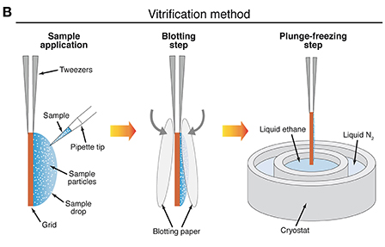
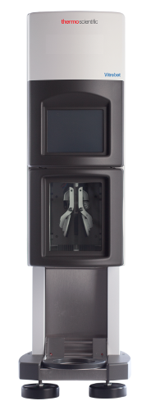
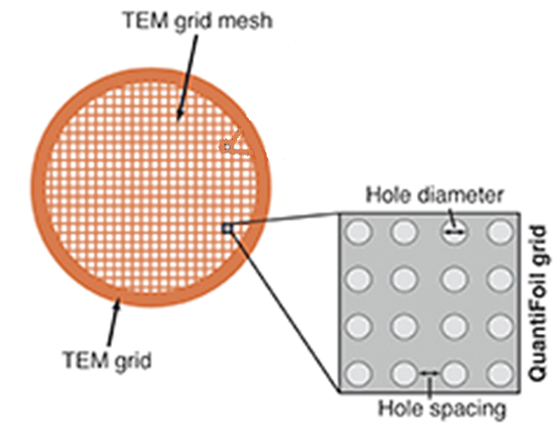
CryoEM – Sample preparation
From: Cryo-EM Grid Preparation of Membrane Protein Samples for Single Particle Analysis
From: FEI website
From: Real-time cryo-electron microscopy data preprocessing with Warp

Slide 13
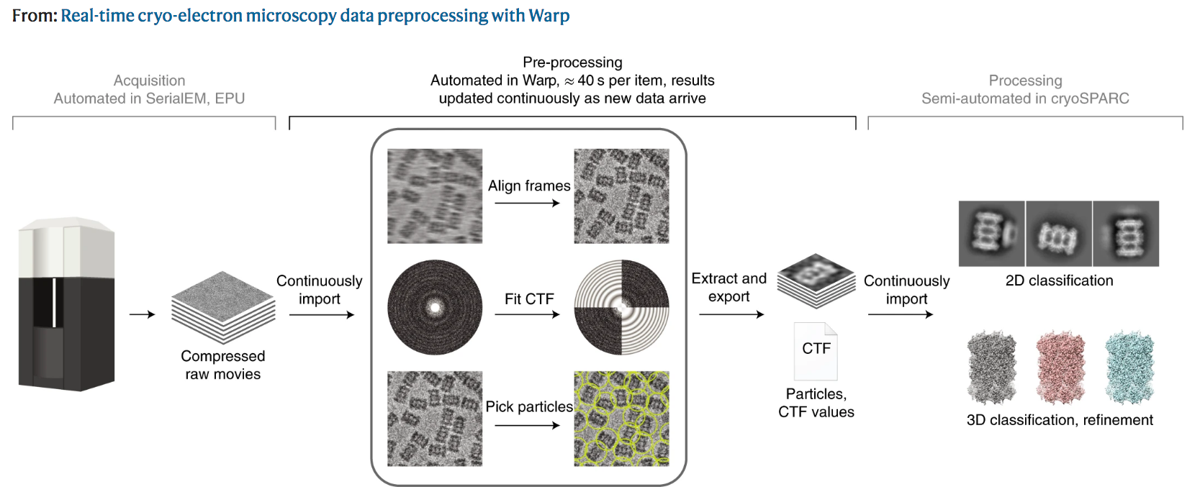
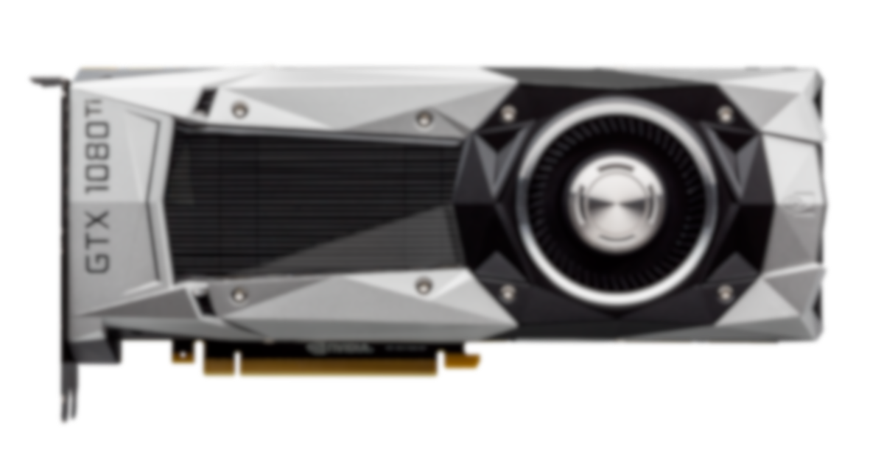
CryoEM--Single Particle Analysis (SPA)
From: Real-time cryo-electron microscopy data preprocessing with Warp
From : nVIDIA

Slide 14
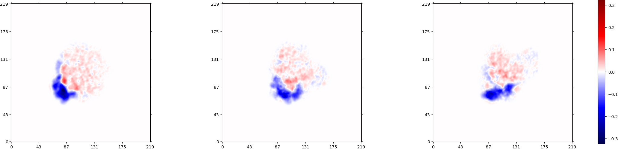
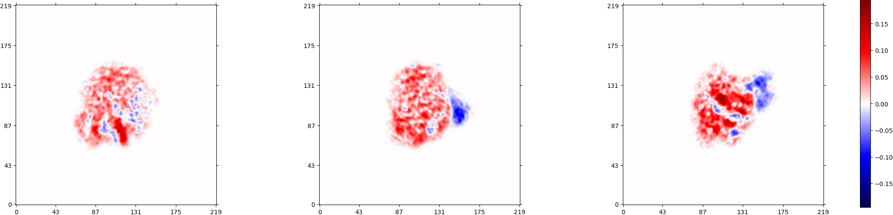
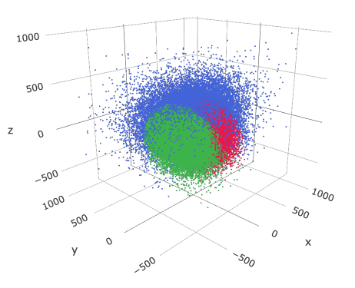
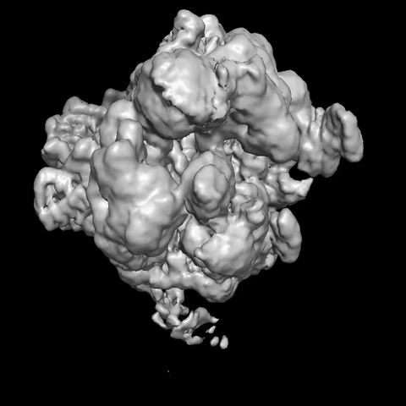

New generation Algorithm for 3D analysis
Notes:
算完之後 再用Display 調整想要分的cluster 數量

Slide 15
Experimental Result

Slide 16
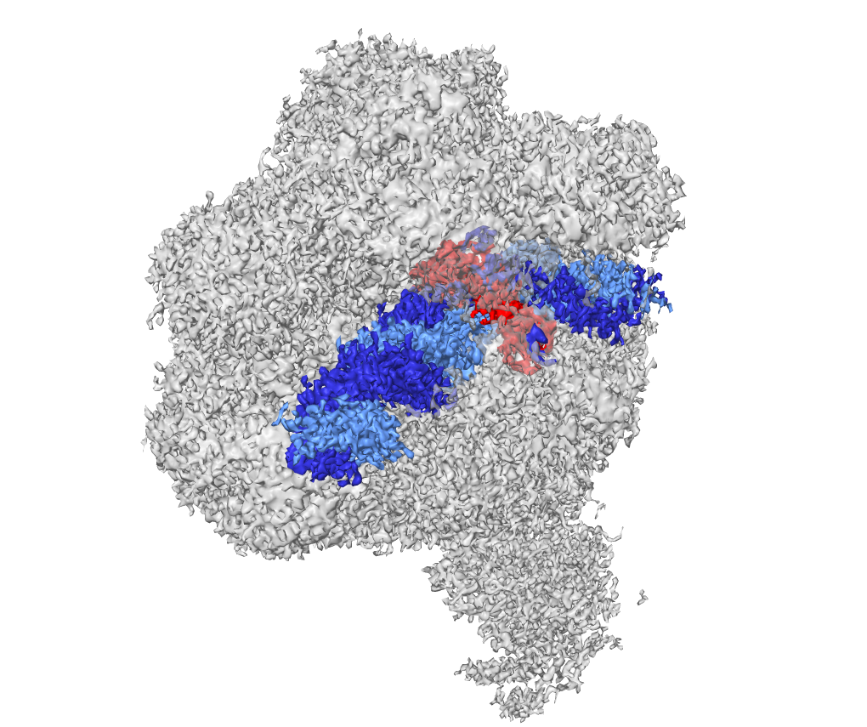
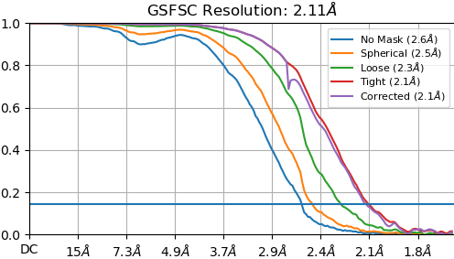
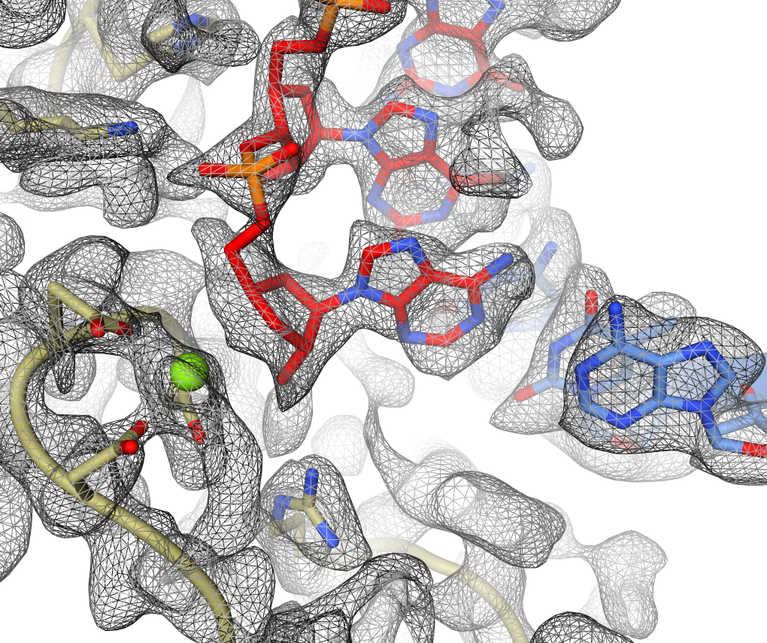
Reconstruction of RNA polymerase
RNA Polymerase II
Micrographs no. : 25,522
Picked particle no. : 6,990,280
Selected particles no. : 1,338,968
Upstream
side
Downstream
side
RNA
Template DNA
Non-template DNA
Notes:
待改進
單色map 高清圖1
Pol2 TFIIF 分色Focus 圖2
放入PDB 5fyw 解釋有無 圖3

Slide 17
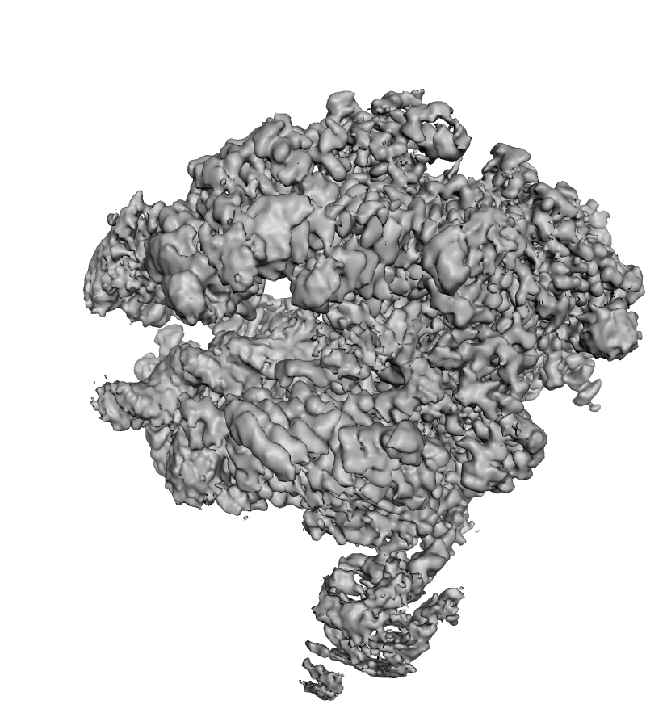
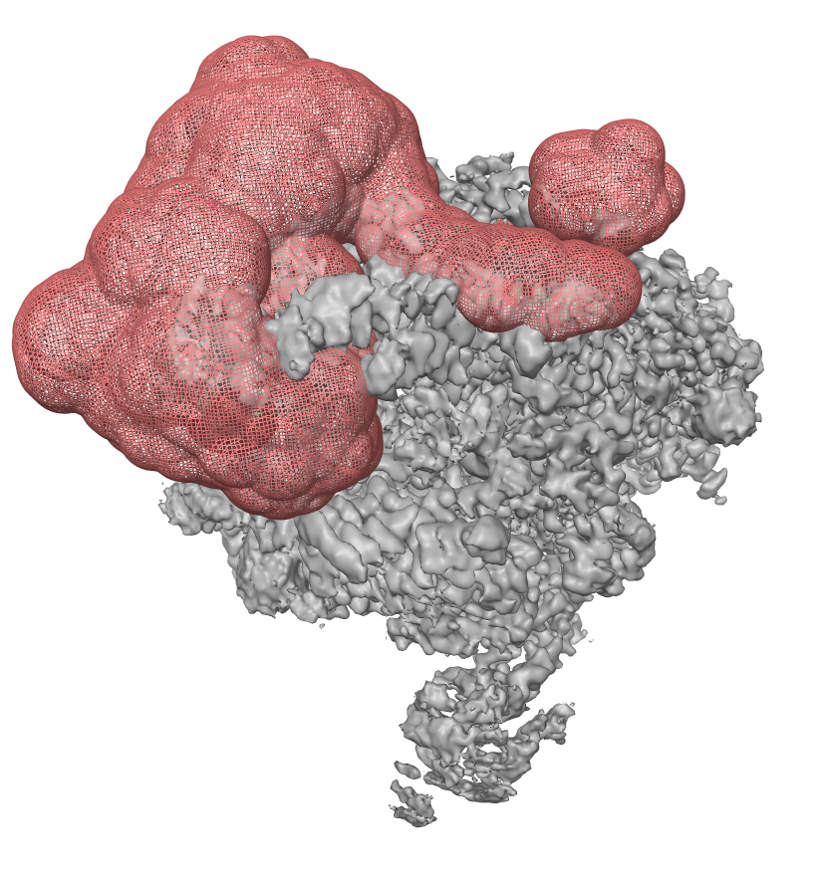
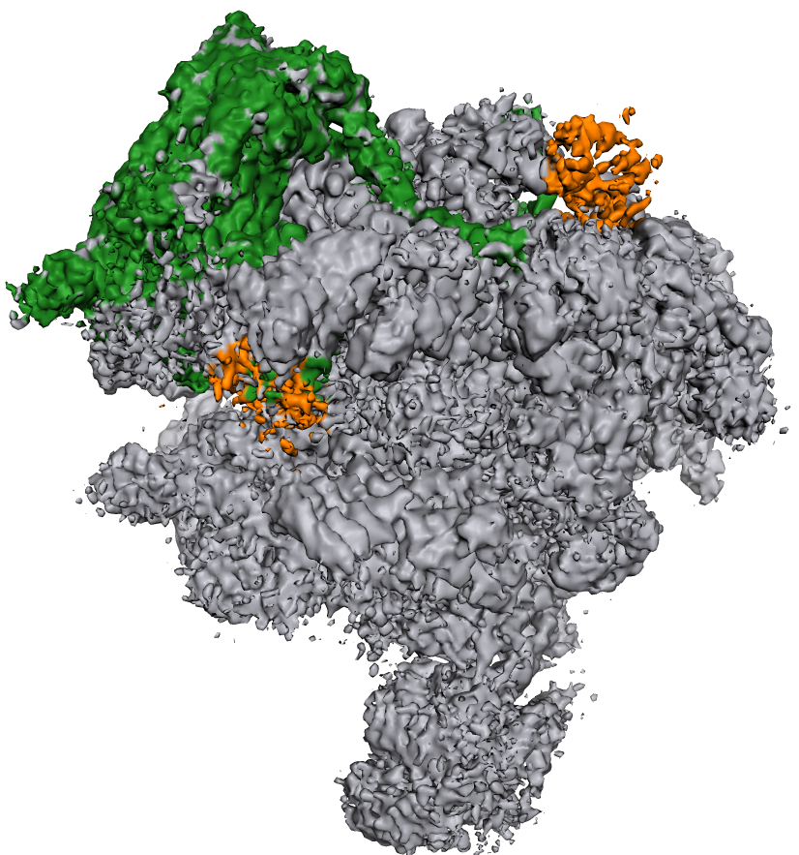
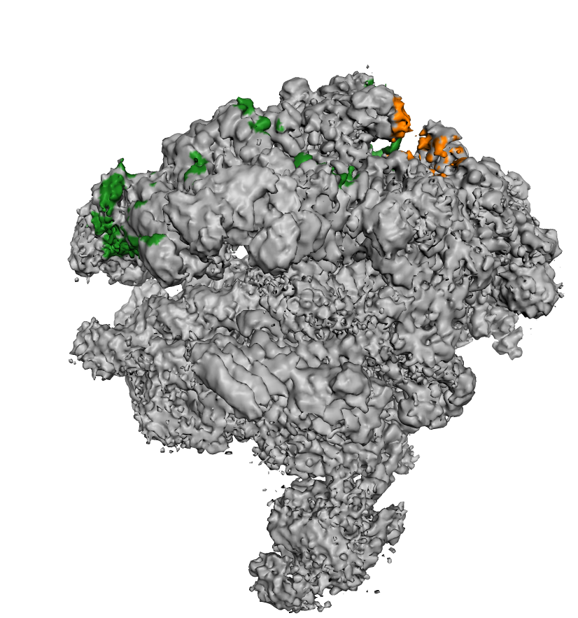
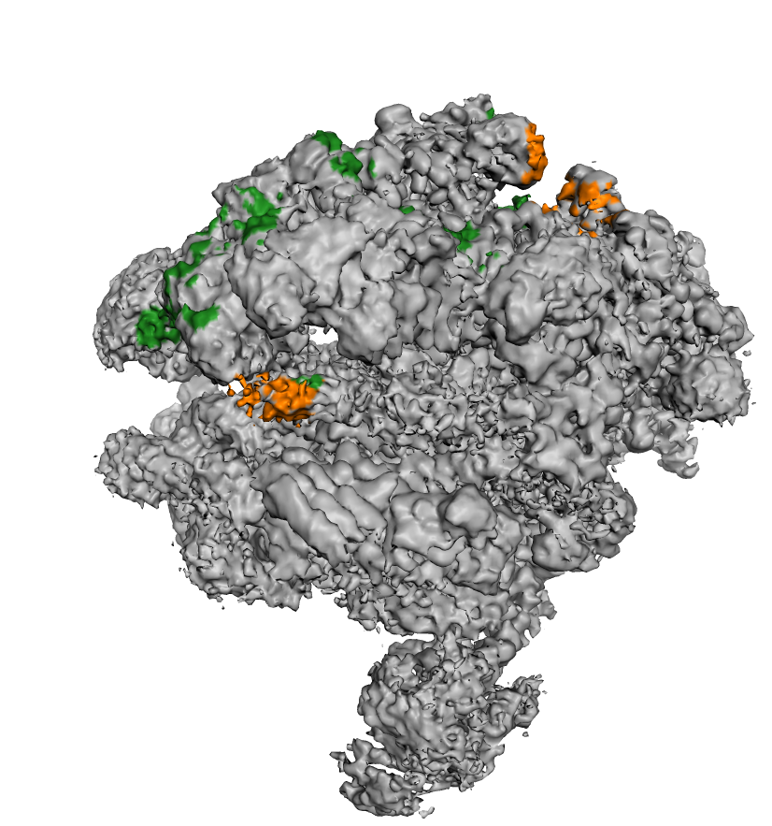
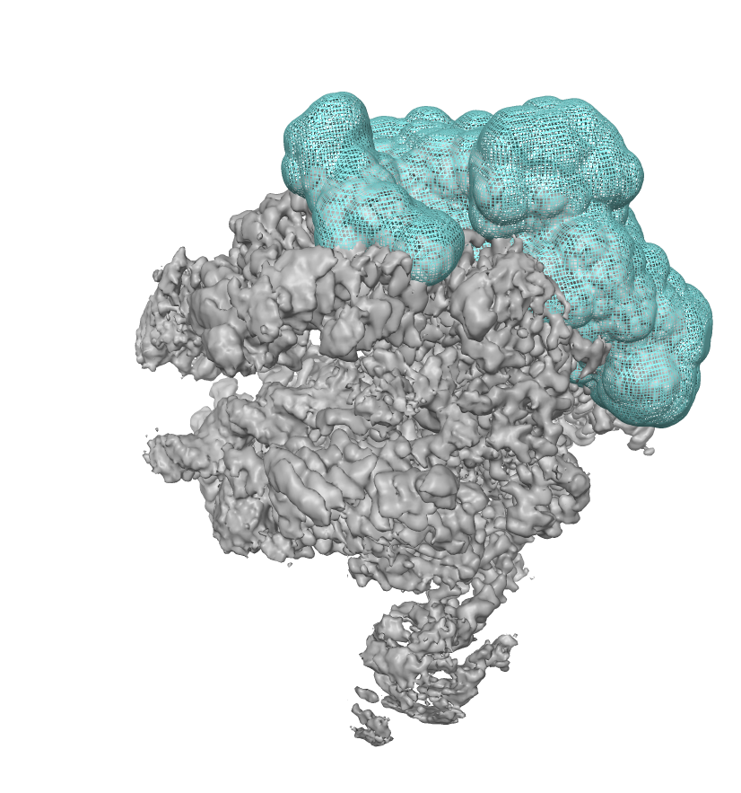
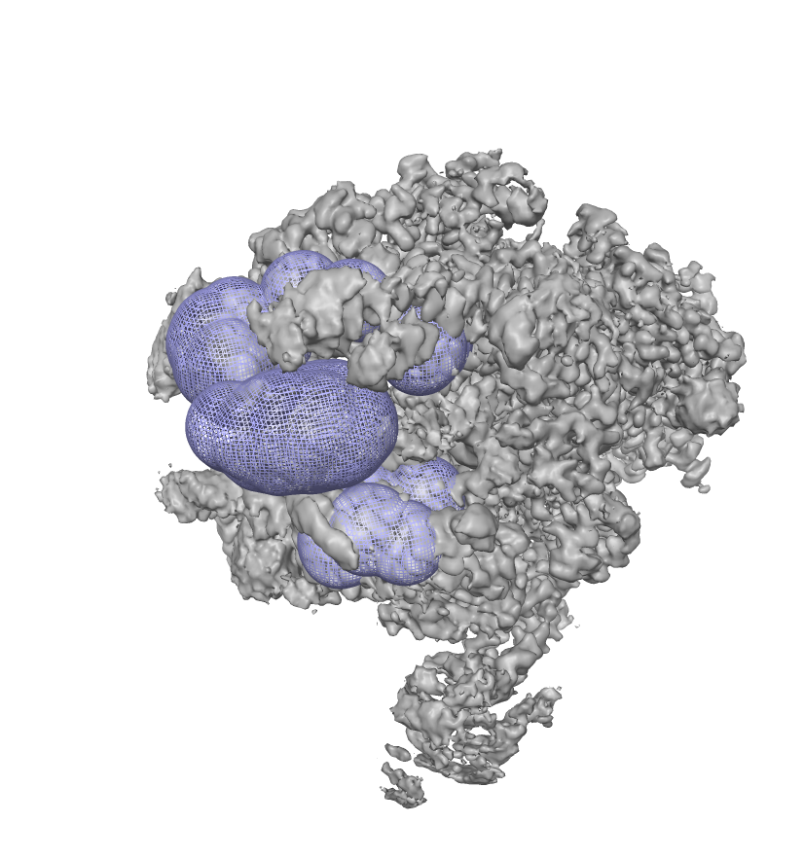
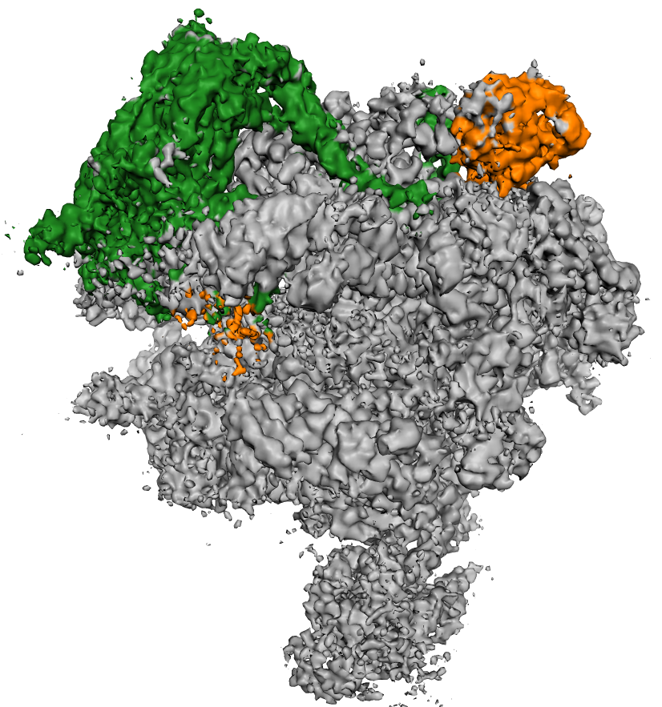
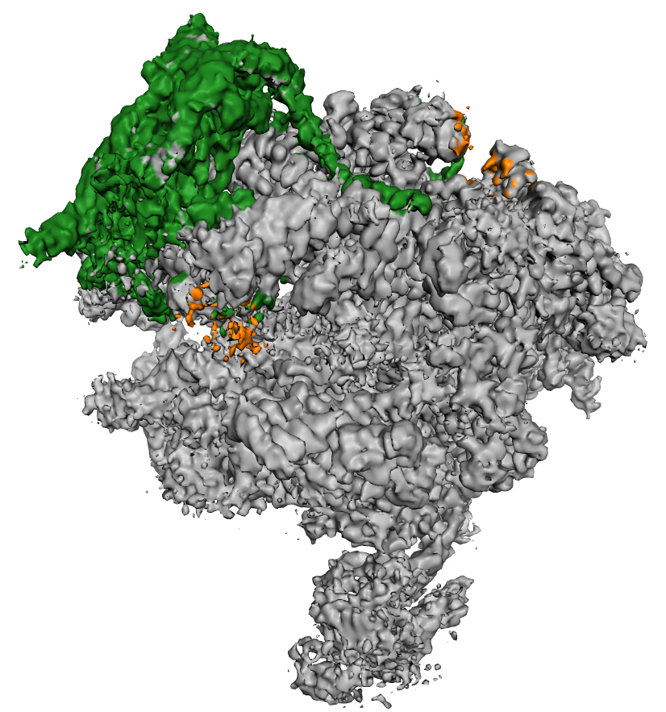
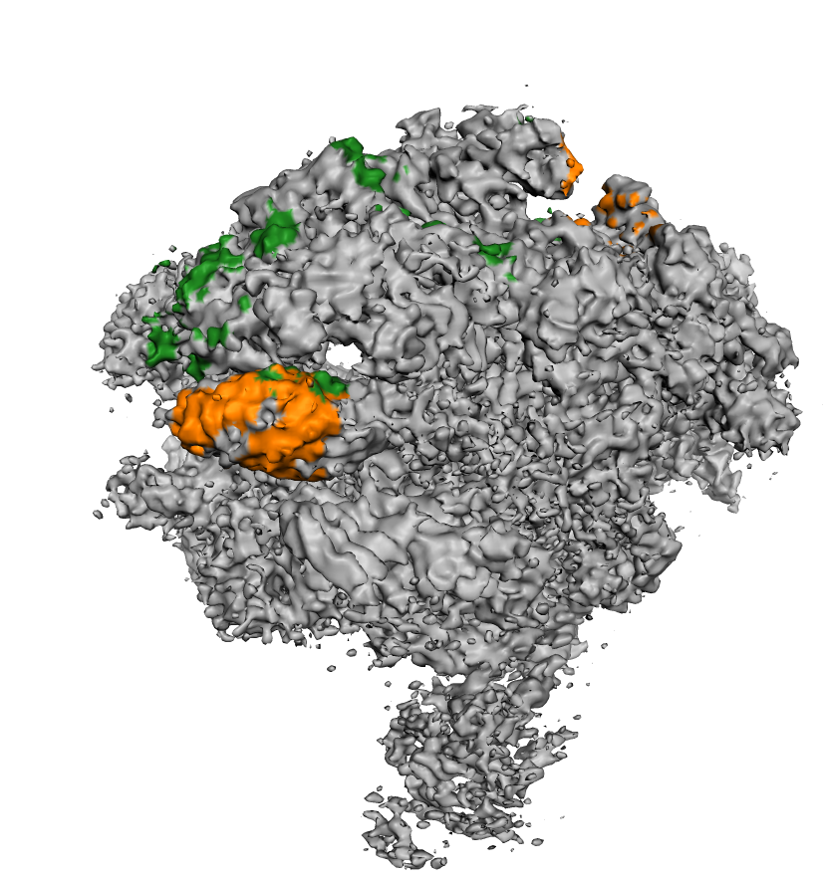
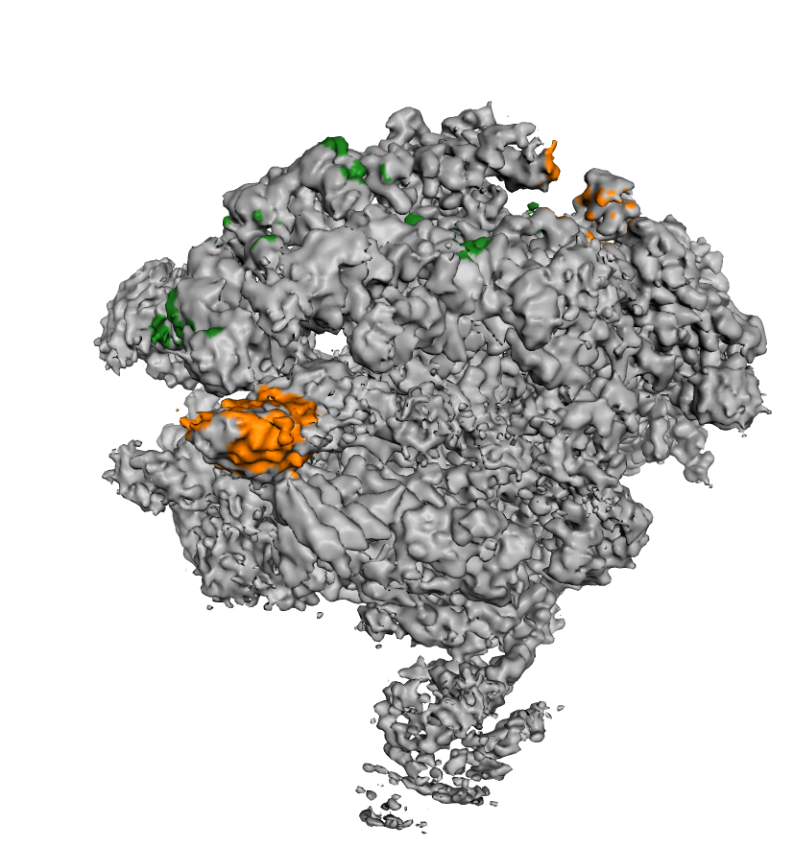
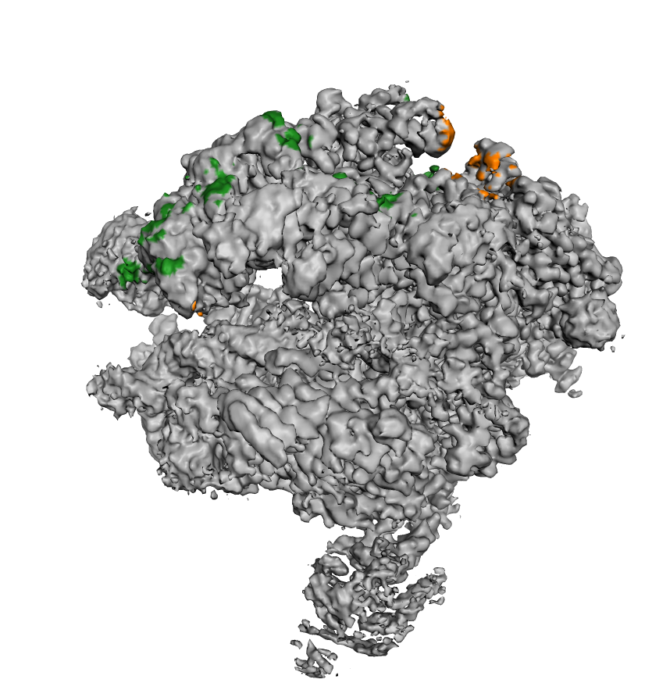
3D Classification via 3DVA
Total particle no. : 1,338,968
Mask Design
16.9%
42.2%
40.9%
Mask Design
Mask Design
28.6%
71.4%
10.8%
24.1%
65.1%

Slide 18
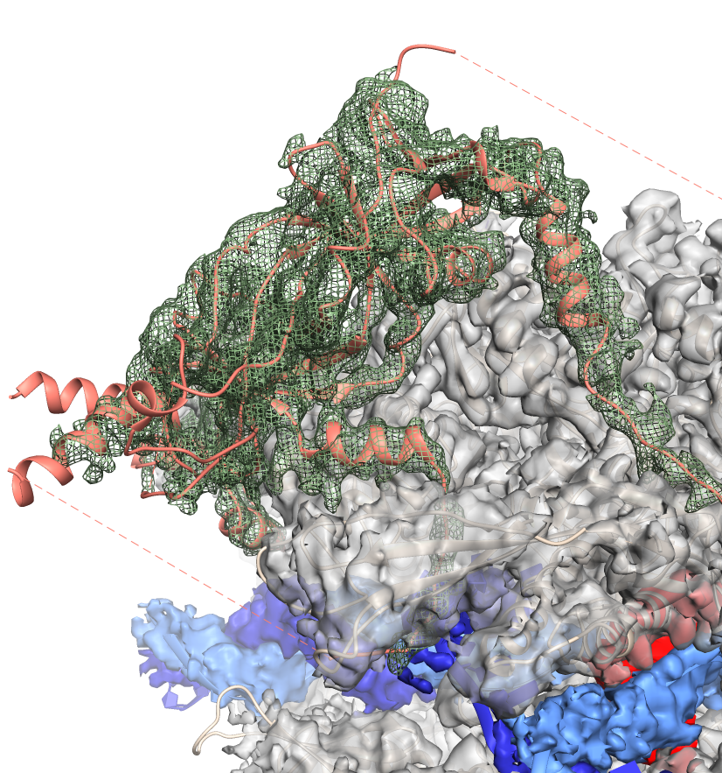
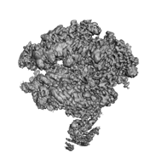
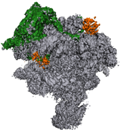
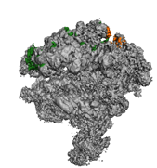
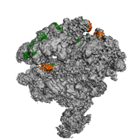
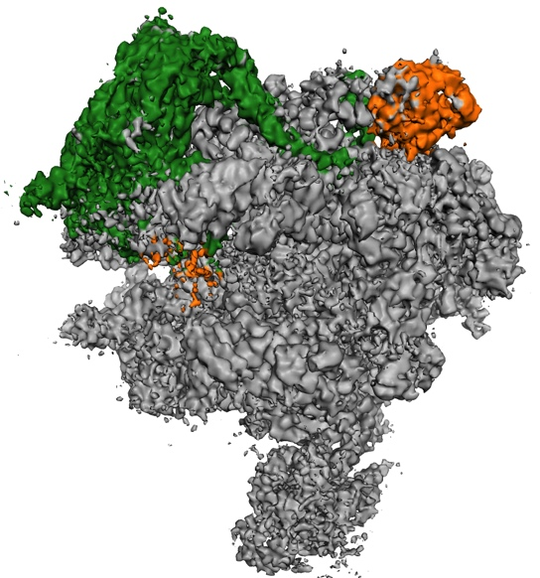


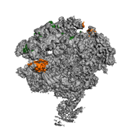
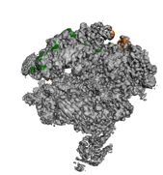
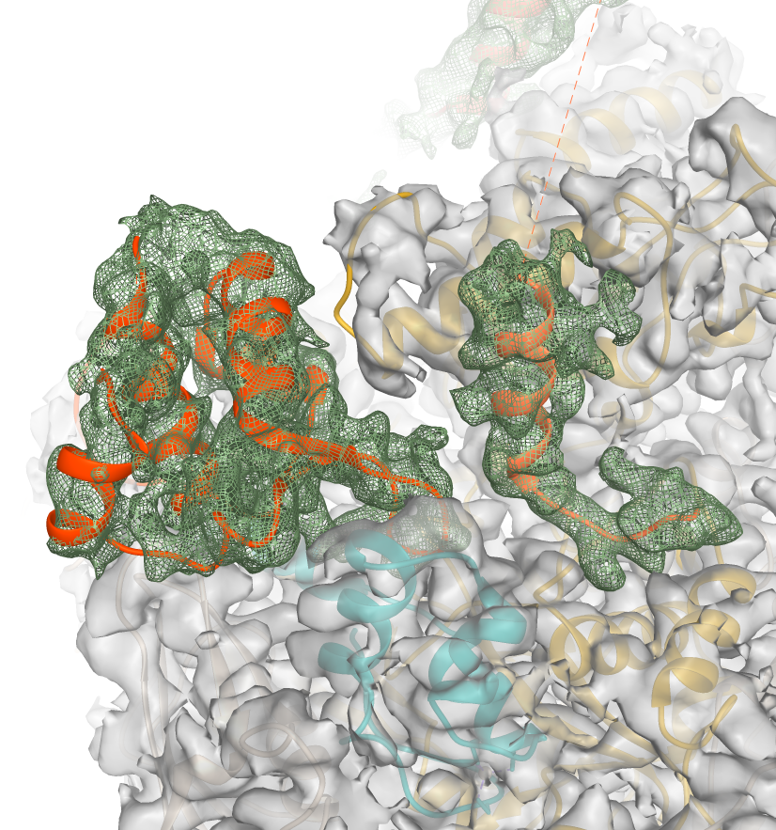
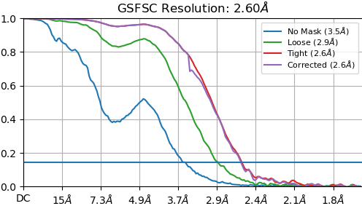
Obvious TFIIF density reveal alternative state
TFIIF
D-domain
Tfg2-WH
Rpb2
Tfg1
N-term
Rpb10

Slide 19
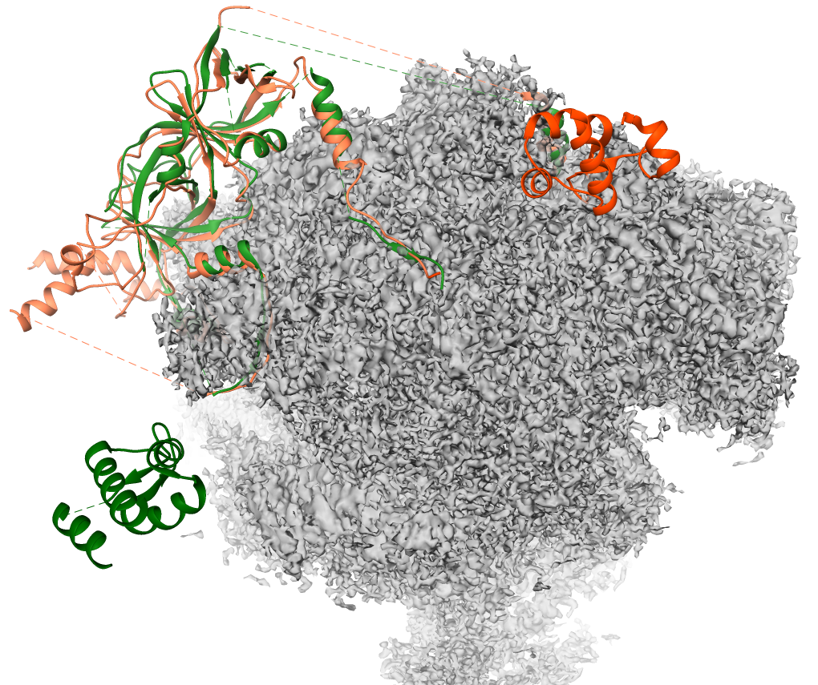
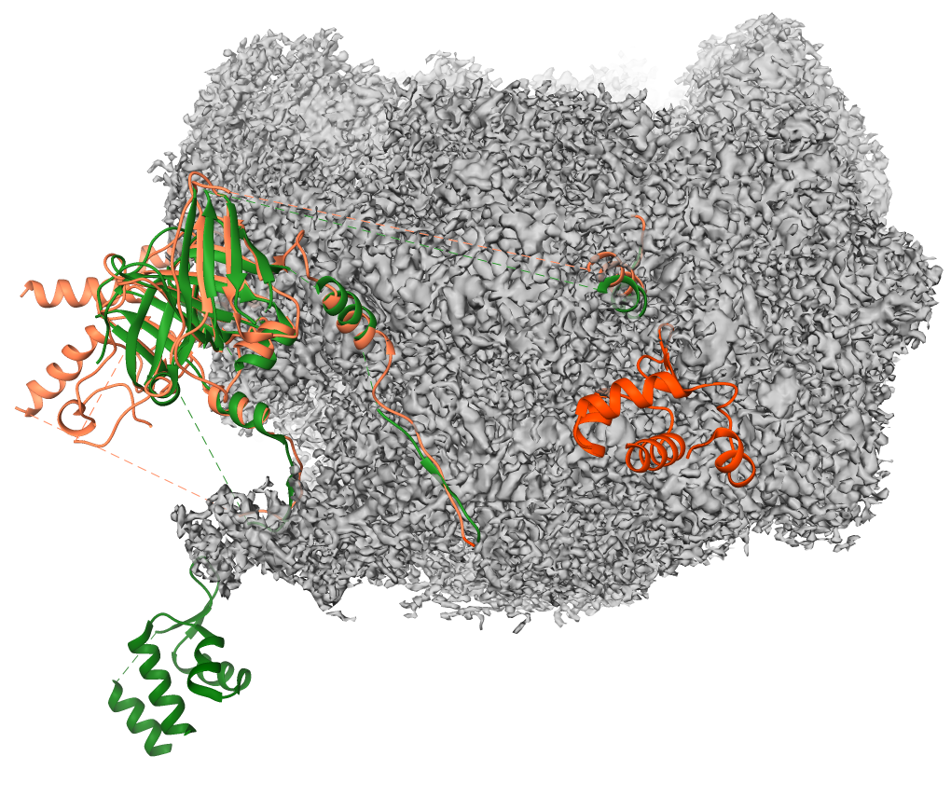
The Movement of Tfg2-WH
D-domain
Our docking
Tfg2-WH
D-domain
90°
Tfg2-WH
In PIC (5fyw)
Rpb4/7
98.3Å
TFIIF (green) : pre-initiation complex (PDB:5FYW)
TFIIF (orange) : our elongation complex

Slide 20
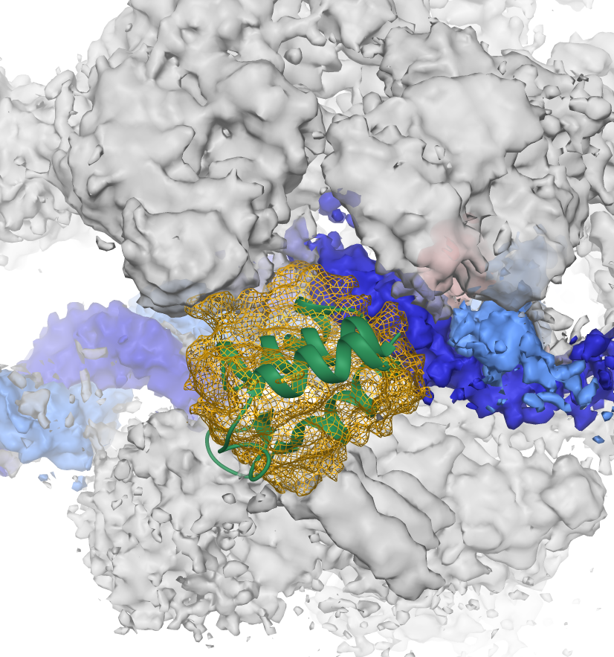
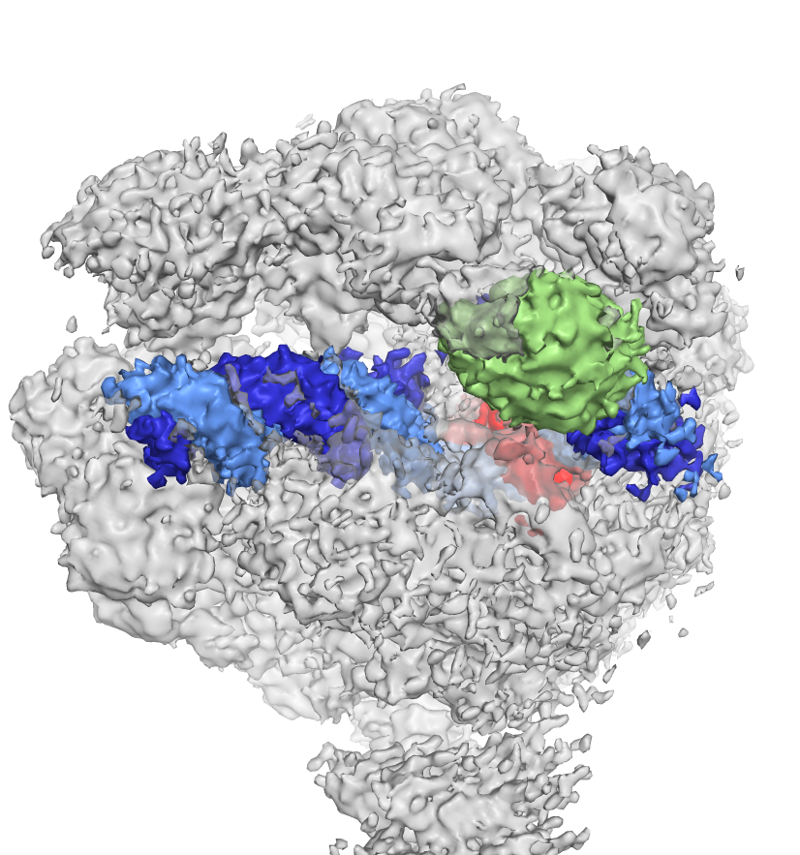
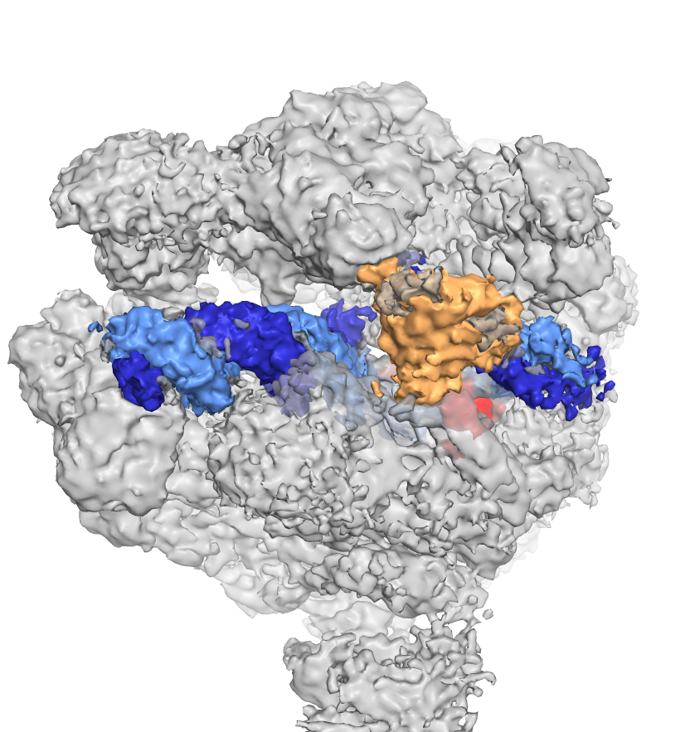
Low-definition Density Map at Cleft of RNAP
Docking a candidate (WH-domain) to judge the low-resolution volume
Lobe
protrusion
Downstream
DNA
Tfg2-WH
Docking
Upper
Lower
Clamp
2.65Å
2.50Å

Slide 21
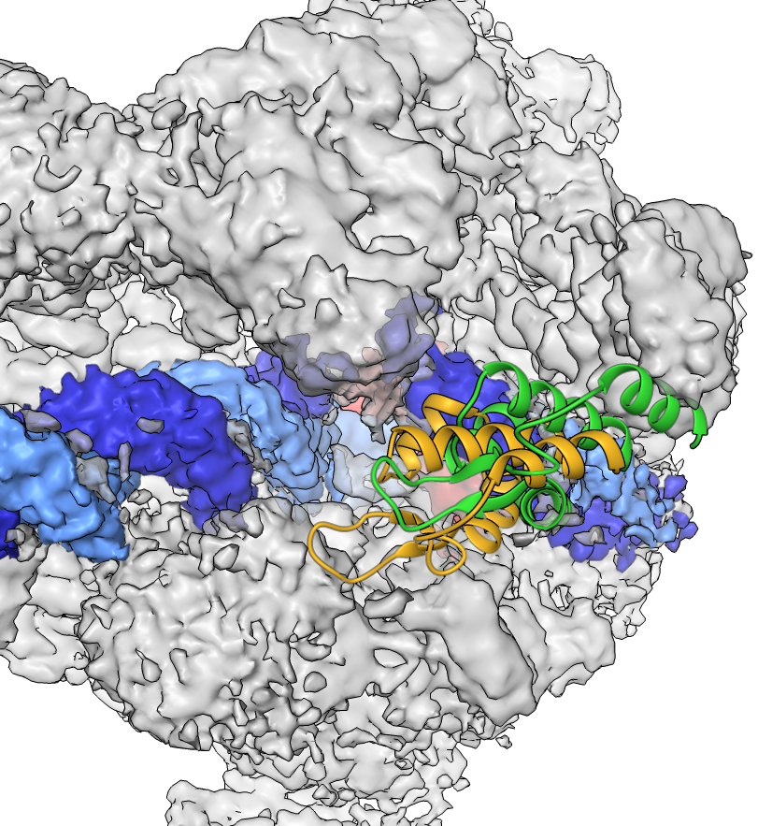
The Vibration of Tfg2-WH
Lobe
RNAP-II
protrusion
DNA
Upstream
DNA
Downstream
8.5Å
Clamp
Tfg2-WH
Rpb4/7

Slide 22
Discussion -- Mobility of TFIIF
Small move
Cleft Nearby vibrating
Big move
From Cleft to Rpb10
Our docking
Tfg2-WH
Lobe
RNAP-II
protrusion
DNA
Downstream
Cleft
DNA
Upstream
Clamp
Tfg2-WH
In PIC (5fyw)
Rpb4/7
Rpb4/7

Slide 23


single molecule Fluorescence Resonance Energy Transfer
(smFRET)
Notes:
https://www.hatzakislab.com/ Cy3 Cy5: https://en.wikipedia.org/wiki/Cyanine

Slide 24
FRET efficiency histogram
FRET pair: Cy3B-Tfg2-D311 and Cy5-T-DNA(+4)
center:
σ:
0.26
0.163
0.67
0.144
0.87
0.057
R²: 0.958
TFIIF
Active site
WH
Built up from 15 time traces
Total 3,523 data points
Collaborate with Dr. Jheng-Syong Wu

Slide 25

Discussion – TFIIF coexist with spt4
TFIIF in our model
Alternative location of WH allows the possibility of coexistence
Spt4 in PDB:5XON
Spt4 is one of essential factors in elongation

Slide 26
Conclusion
The density map of RNAP-II EC complex with TFIIF was shown by cryoEM in high resolution.
A clear interface for tfg2 WH-domain and Rpb10 provides structural information for further functional assay.
A rough density map vibrating at the cleft of RNAP-II, and the volume seems to match with WH-domain.
The mobility of tfg2 WH-domain may support its multifunction or character in different states.

Slide 27
The End
Thank you

Slide 28
Reference
Barnes et al., Crystal Structure of a Transcribing RNA Polymerase II Complex Reveals a Complete Transcription Bubble, Molecular Cell, Volume 59, Issue 2, 258-269 (2015)
Alessandro Vannini, Patrick Cramer et al., Conservation between the RNA Polymerase I, II, and III Transcription Initiation Machineries, Molecular Cell, Volume 45, Issue 4, 439-446(2012)
Plaschka, C., Hantsche, M., Dienemann, C. et al., Transcription initiation complex structures elucidate DNA opening. Nature 533, 353–358 (2016).
Eichner, J., Chen, H.‐T., et al., Position of the general transcription factor TFIIF within the RNA polymerase II transcription preinitiation complex. The EMBO Journal, 29: 706-716(2010).
Scheres SH. A Bayesian view on cryo-EM structure determination. J Mol Biol. 2012 Jan 13;415(2):406-18.
Punjani, A., Zhang, H. & Fleet, D.J. Non-uniform refinement: adaptive regularization improves single-particle cryo-EM reconstruction. Nat Methods 17, 1214–1221 (2020).
Morten Källberg, Haipeng Wang, Sheng Wang, Jian Peng, Zhiyong Wang, Hui Lu & Jinbo Xu. Template-based protein structure modeling using the RaptorX web server. Nature Protocols 7, 1511–1522, 2012
Kelley, L., Mezulis, S., Yates, C. et al. The Phyre2 web portal for protein modeling, prediction and analysis. Nat Protoc 10, 845–858 (2015).

Slide 30
Backup
slide

Slide 31
Native PAGE result
F_{nonCys}
+
S
+
Pol-II
F_{nonCys}
+
S_long
+
Pol-II
S
+
Pol-II
S_long
+
Pol-II
maker
Pol-II
kDa
1236
1048
720
480
242
146
66

Slide 32




N-terminal of Tfg1 is found in all clusters
w/o TFIIF
Form 1
Form 2
Form 3

Slide 33

Alternative location supported by Mass spectrometry
Architecture of the Pol II–TFIIF complex (2010)
ZA Chen, Patrick Cramer and Juri Rappsilber et al

